Slide 1
SmartBuy - AI Based Personalized Shopping
Team members
D Sri Ram-2420030192
K Vamsidhar-2420030341
K.V.S Jaswant-2420030467
Under the guidance of:
Dr. Lavanya Gottumukkala

Slide 2
ABSTRACT
SmartBuy – AI Based Personalized Shopping is an intelligent shopping platform that uses Artificial Intelligence to provide personalized product recommendations based on user preferences, browsing behavior, and purchase history. The system analyzes customer data to understand individual interests and suggest relevant products, helping users make faster and better purchasing decisions. It can also improve the shopping experience through personalized search, product categorization, and recommendations. By combining AI with an easy-to-use shopping interface, SmartBuy aims to reduce product-search time, increase customer satisfaction, and provide a smarter and more efficient online shopping experience.

Slide 3
INTRODUCTION
SmartBuy – AI Based Personalized Shopping is a simplified e-commerce platform designed to provide users with a more personalized shopping experience. Traditional shopping systems mainly depend on manual search, categories, filters, and general product recommendations. SmartBuy focuses on understanding user preferences and shopping behavior to provide more relevant product suggestions. The project integrates React, Spring Boot, MySQL, Git, Docker, Kubernetes, and AWS to develop, manage, and deploy the complete application. The main objective is to understand and implement the concept of personalized shopping using modern software technologies in a practical and manageable way.

Slide 4
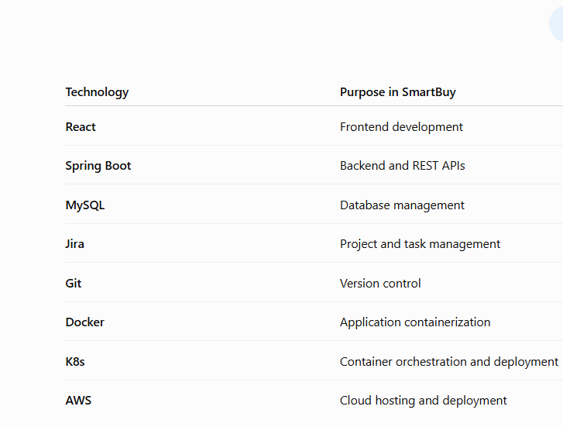
Tools used

Slide 5
Proposed solution
The proposed solution is to develop SmartBuy, a simplified personalized e-commerce platform that analyzes user preferences and shopping behavior to provide relevant product recommendations. The system will use React for the frontend, Spring Boot for the backend, and MySQL for data storage. Jira and Git will be used for project management and version control, while Docker, Kubernetes, and AWS will be used for containerization, deployment, and cloud hosting.

Slide 6
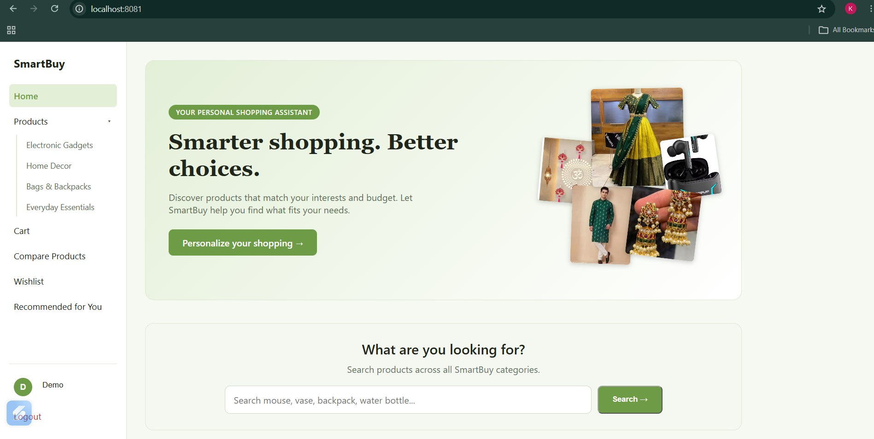
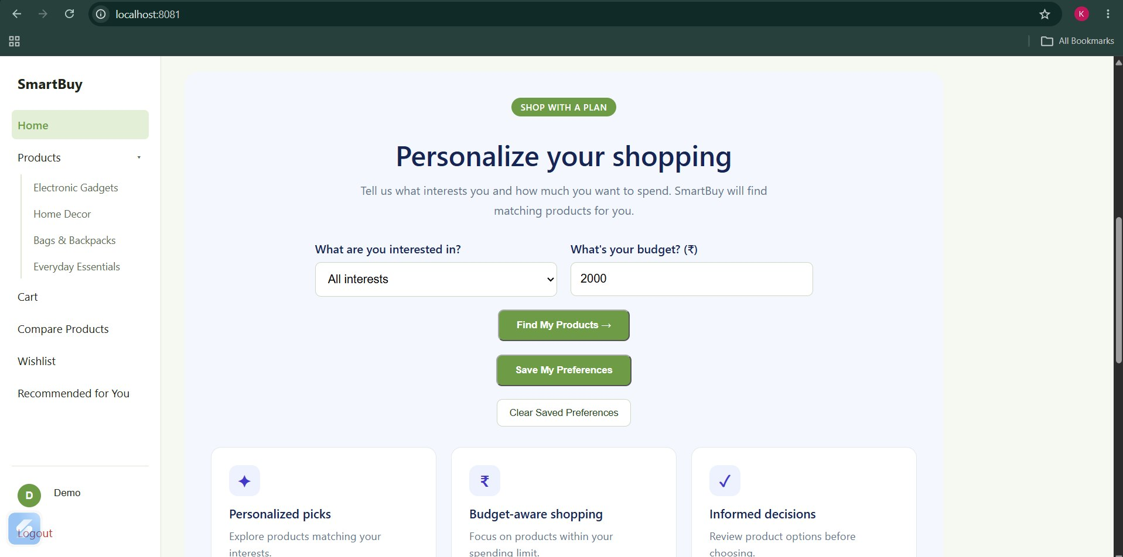
Result

Slide 7
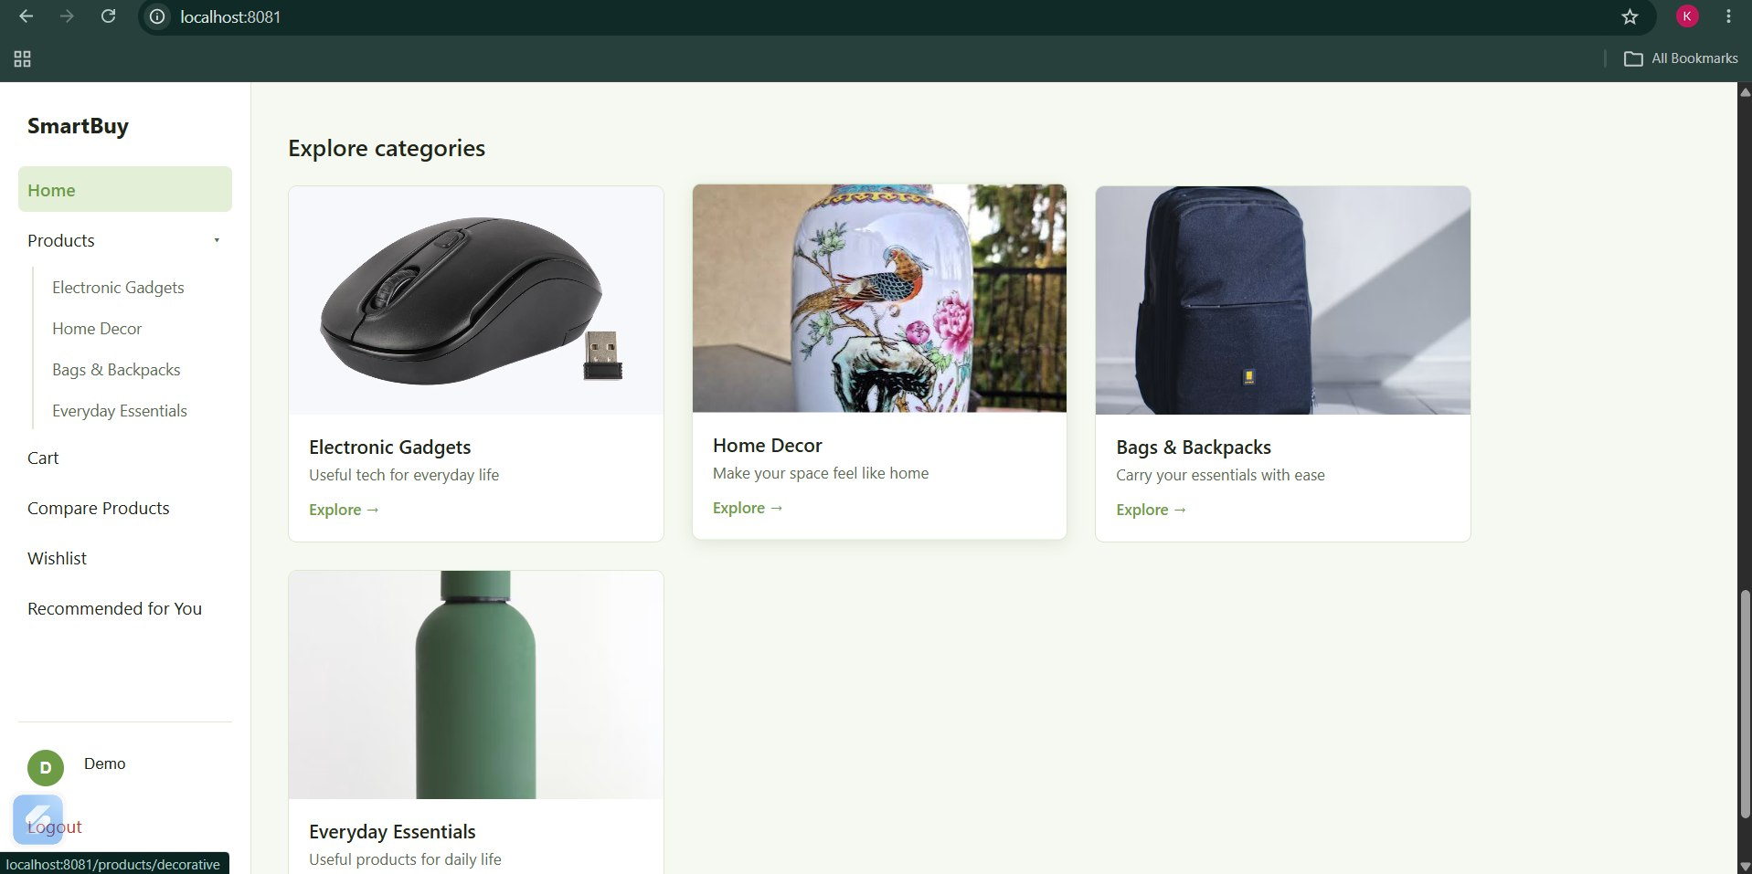
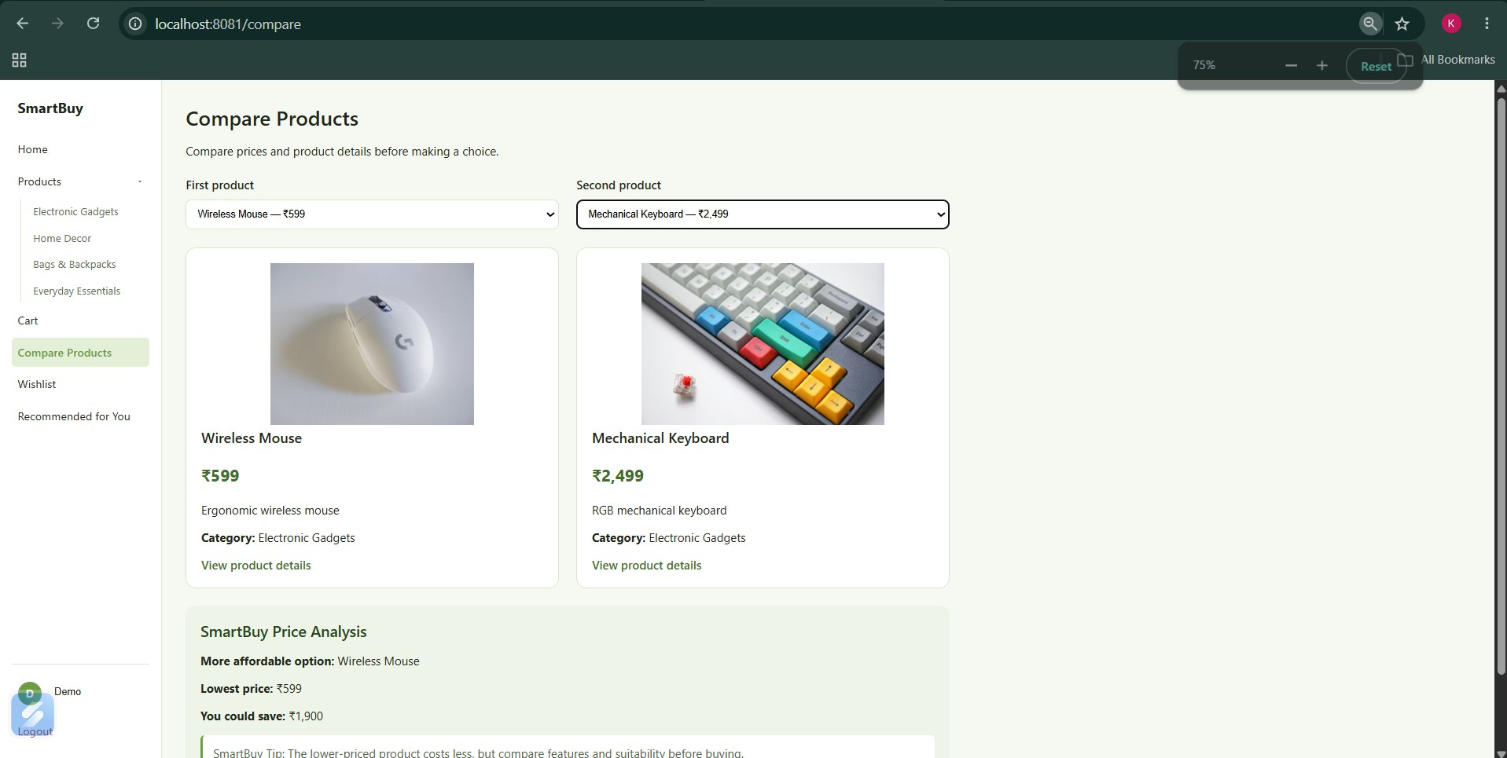
Result

Slide 8
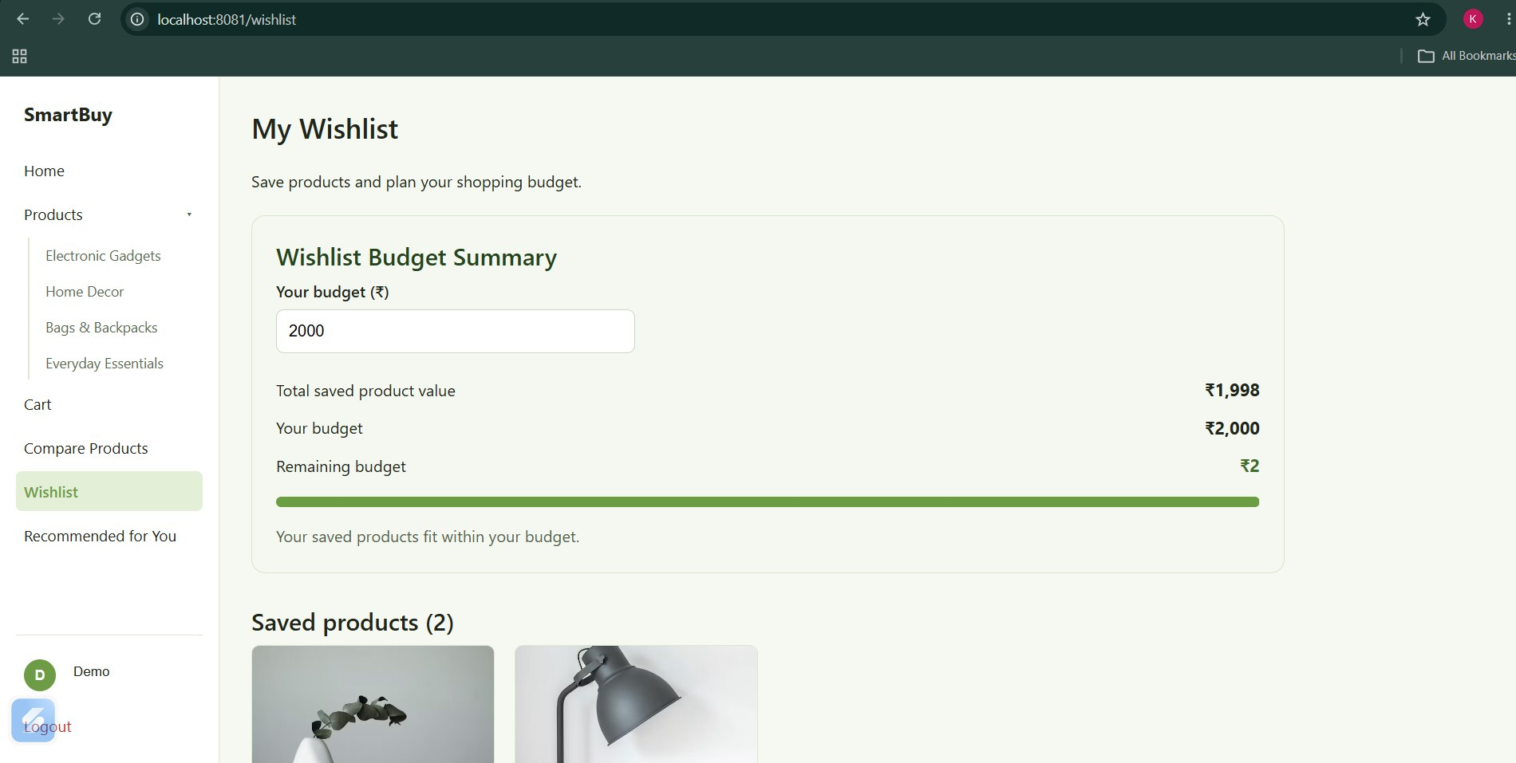
Result

Slide 9
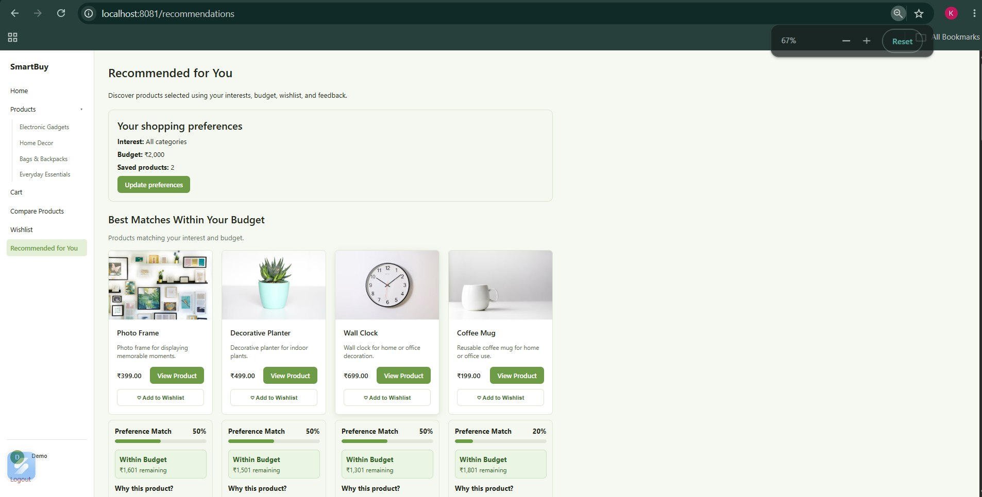
Result

Slide 10
THANK YOU

